Slide 1
RDS / RDSadmin Architecture, System, Program & Screen Shot
Jacky Lue
2016/03/11

Slide 2
Content
Architecture Background
System Concept
Program Overview
RDS Program
RDS-admin Program

Slide 3
Architecture Background

Slide 4
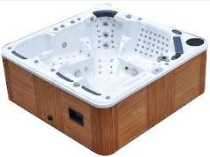
SPA….. You are not alone !
Peripheral Devices
SPA
Internet,
Cloud
Home Network

Slide 5
Connections in New-SPA architecture
Internet
Purpose: Remote access
Connect to/from: mobile App, homepage,…
Home network
Purpose: Home Automation
Connect to/from: TV, Phone, IPCAM, Thermostat,…
Device Local network
Purpose: Internal ctrl/data
Reserve expand capability for New-SPA Adding new device to enhance User experience

Slide 6





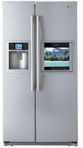

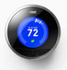



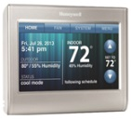
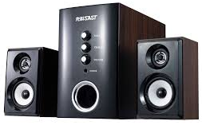


New SPA External Architecture
Wireless connecting Peripheral Devices
Local Network
Internet , Public cloud, Private cloud….
SPA Company
Internet/cloud Company
Local Database
Application Server
Web Server
Big data
Database
Call-center
Home Network

Slide 7
System concept

Slide 8
High Level Concept on RDS
Original start point :
Reduce communication time in call-center
Take right parts when on-site service (go to user-Home)
Add-on (with Cloud)
Analysis user behavior (for future product planning)
Provide add-on service
Push new product information

Slide 9


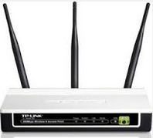



Through internet, SPA company could reach user machine directly
SPA company
1 to many, always
1 to 1, when control/diagnosis
Cloud
Data Base SQL-server
Application Server
Internet
intranet
User in Home
Web Server
User out of Home
Call-center

Slide 10


Architecture of RDS
SPA connected
Not connected
Server version RDS
Simple version RDS
Machine
Logging
Database
Customer Database
Only one
machine
Machine ID
50K ~ 500K machines
Customer
Information
消耗品紀錄
購買紀錄
➔ Remind !
Connect
&
Diagnosis
Polling /Logging
Every Machine
And Analysis
Web-site
Homepage
Mobile
App
Push
Information
Call-center
User

Slide 11
What we provide?
Past:
Mobile App for SPA control
Current Stage:
Mobile App
RDS (with NAS) for call-center
Future:
Mobile App
RDS (server ver.) for call-center
Active services…

Slide 12
Program overview

Slide 13

Scenario (1/2) Inside Call-Center
Call-center operators
Call-center
Manager
NAS
Storage
RDS program
RDS admin program

Slide 14
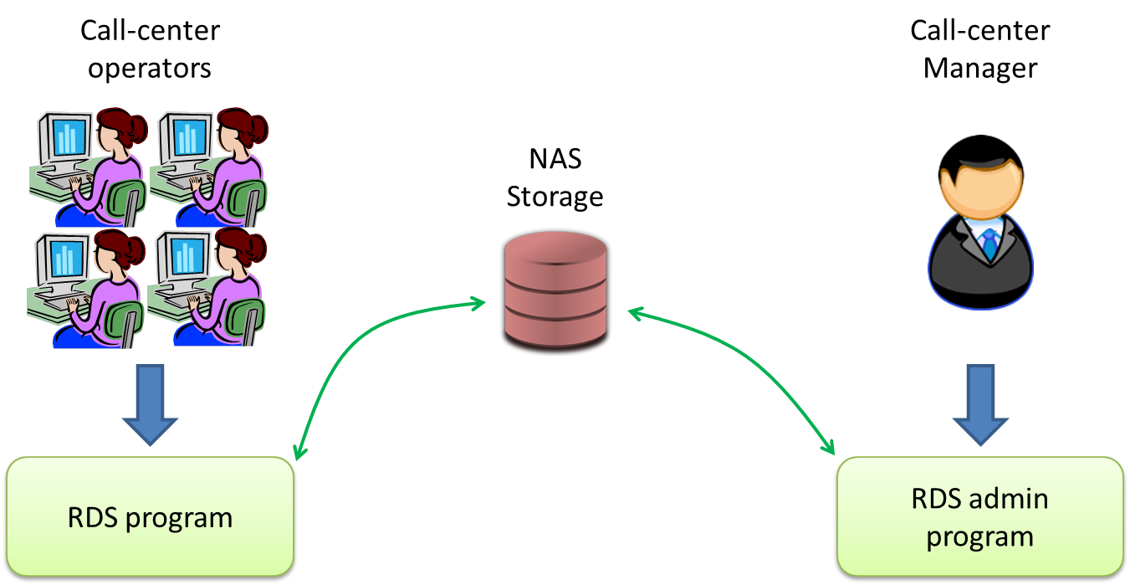

Scenario (2/2) Database Integration
SPA Company /dealer
Service Database
MIS
SPA Company /dealer
Customer Database

Slide 15
Overview (current version)
Two program
RDS for call center operators
RDS-admin for manager
Work with NAS as center storage (not work with center database)
Account
RDS report:
save by UID
save by Date
Operation record (by RDS accounts)
Open service call

Slide 16
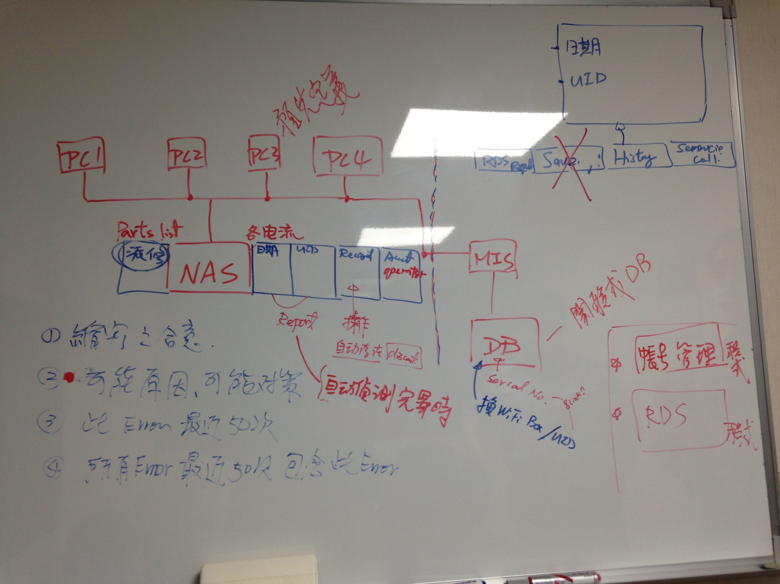
Original discussion at 2016-Jan, by Thomas, Jacky, Judy.

Slide 17
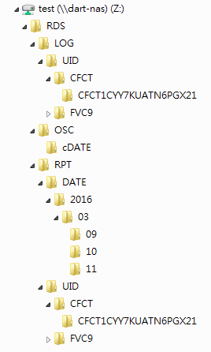
Directories in NAS
Z:\RDS system root directory
Z:\RDS\RPT report root directory
Z:\RDS\RPT\UID report saved by UID
Z:\RDS\RPT\DATE report saved by Date
Z:\OSC current open service call
Z:\OSC\cDATE closed service call
Z:\LOG\UID operation record (by UID)

Slide 18

Files Create & Delete in NAS
Call-center operators
Process then Delete !
Create
Only!
Company
Service DB
Company
Customer DB
NAS
Storage
MIS
RDS program

Slide 19
RDS program

Slide 20
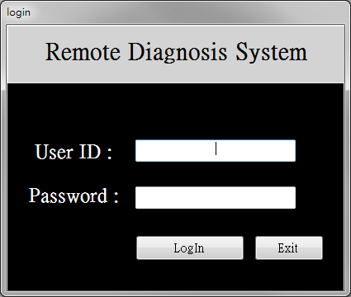
RDS (1) : Login

Slide 21
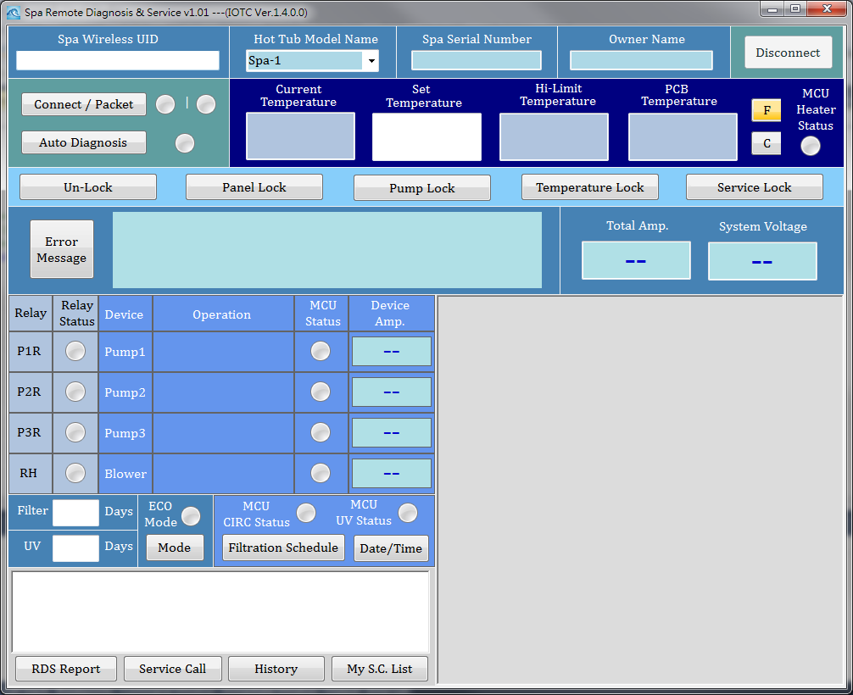
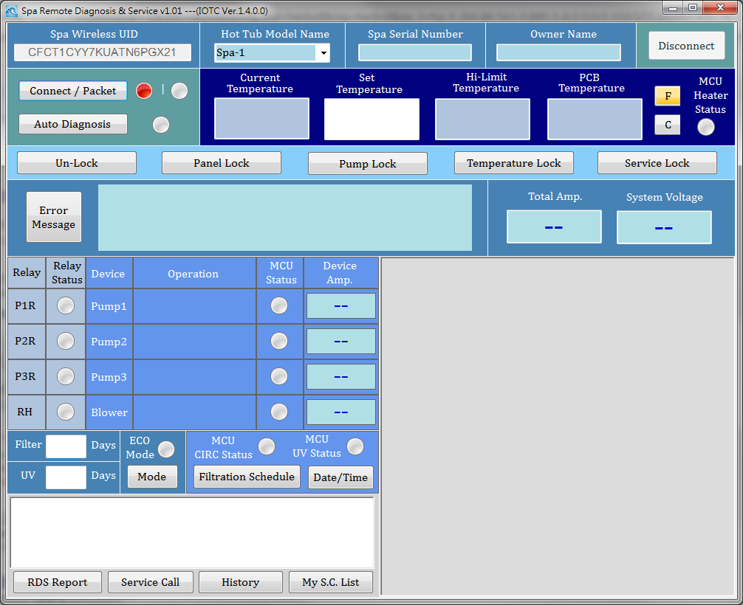
RDS (2) : Main
Input UID
If connect ion fail…

Slide 22
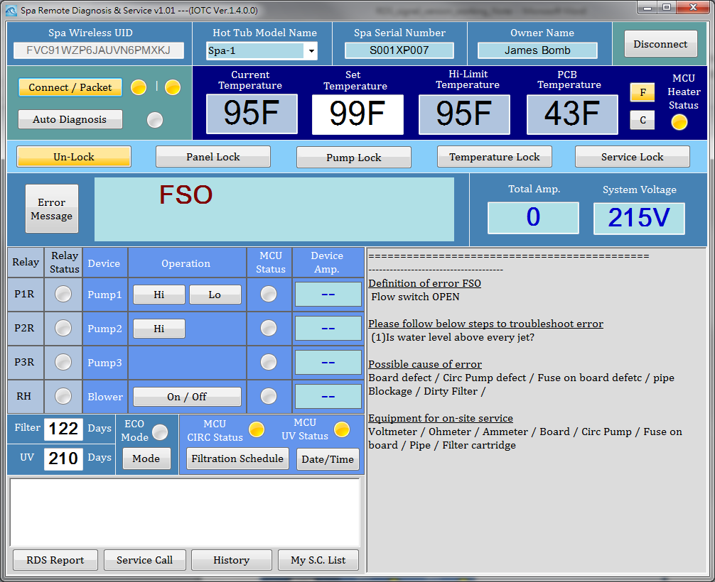
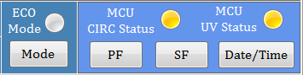
RDS (3) : Connected
If this UID
had connecting history,
Auto-shows basic Info.
Auto-show information
Related to current Error
High-end model
Auto detect & show..
Low-end model

Slide 23
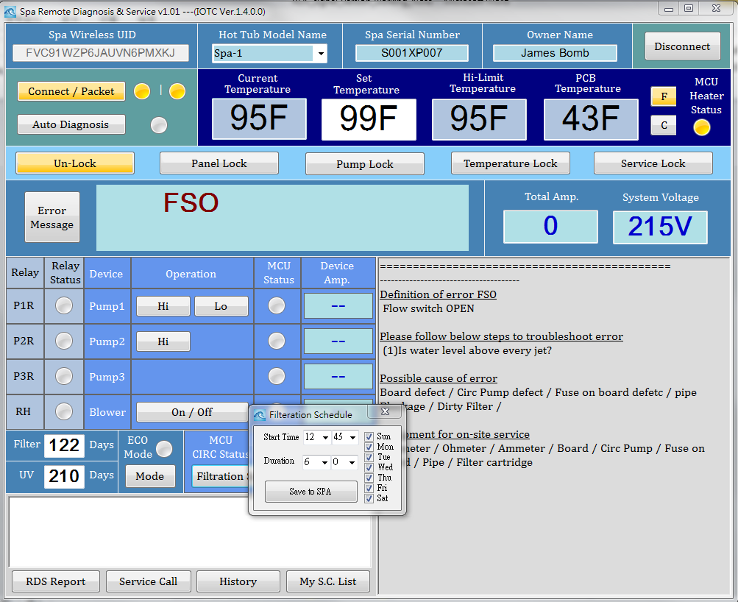
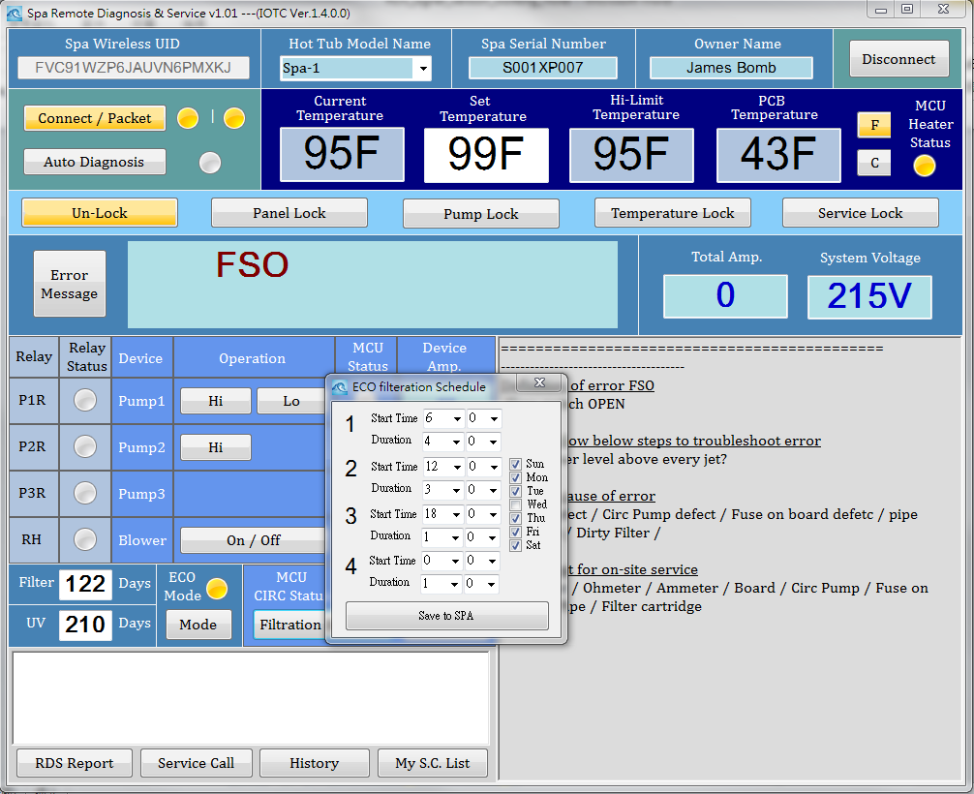
RDS (4) : Change Filter Schedule
High-end Model
When ECO is off
When ECO is on

Slide 24
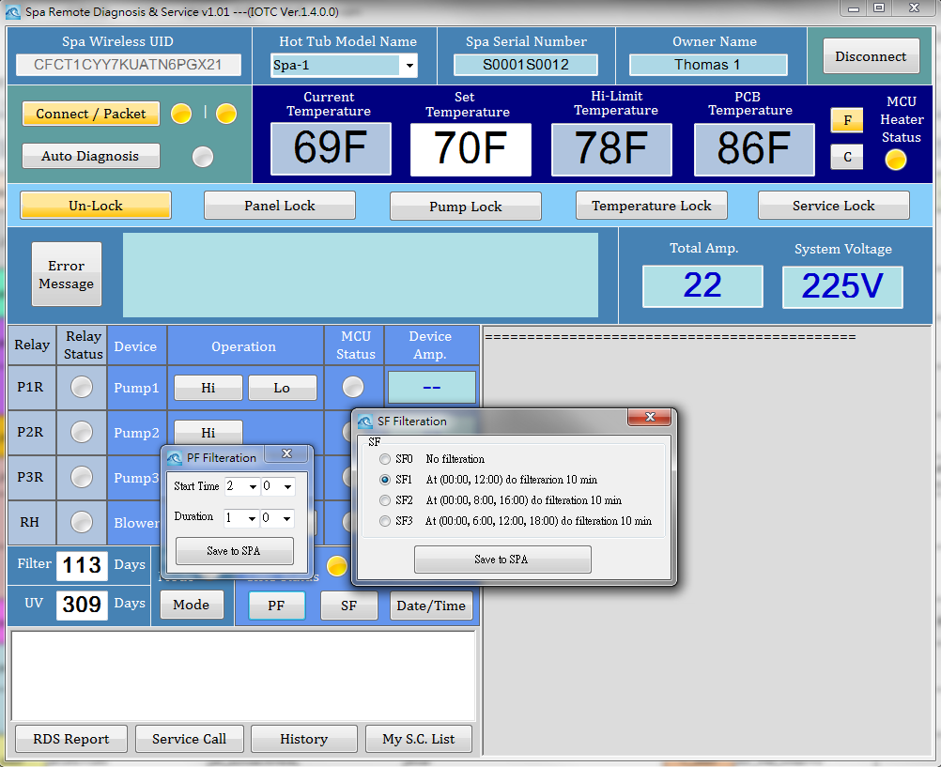
RDS (5) : Change Filter Schedule
Low-end Model

Slide 25
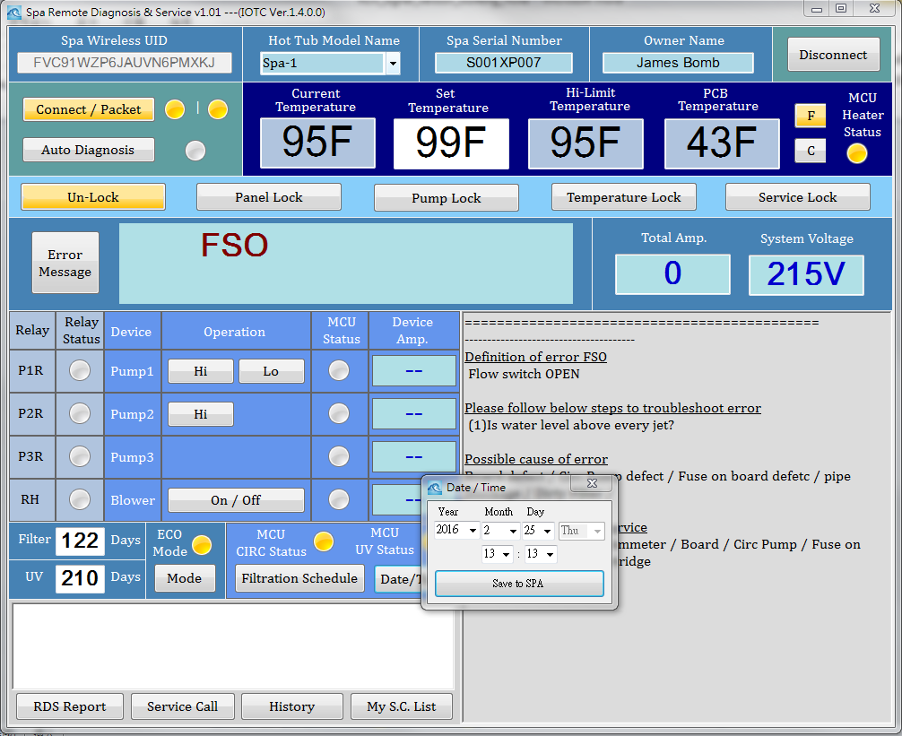
RDS (6) : Change Date/Time

Slide 26
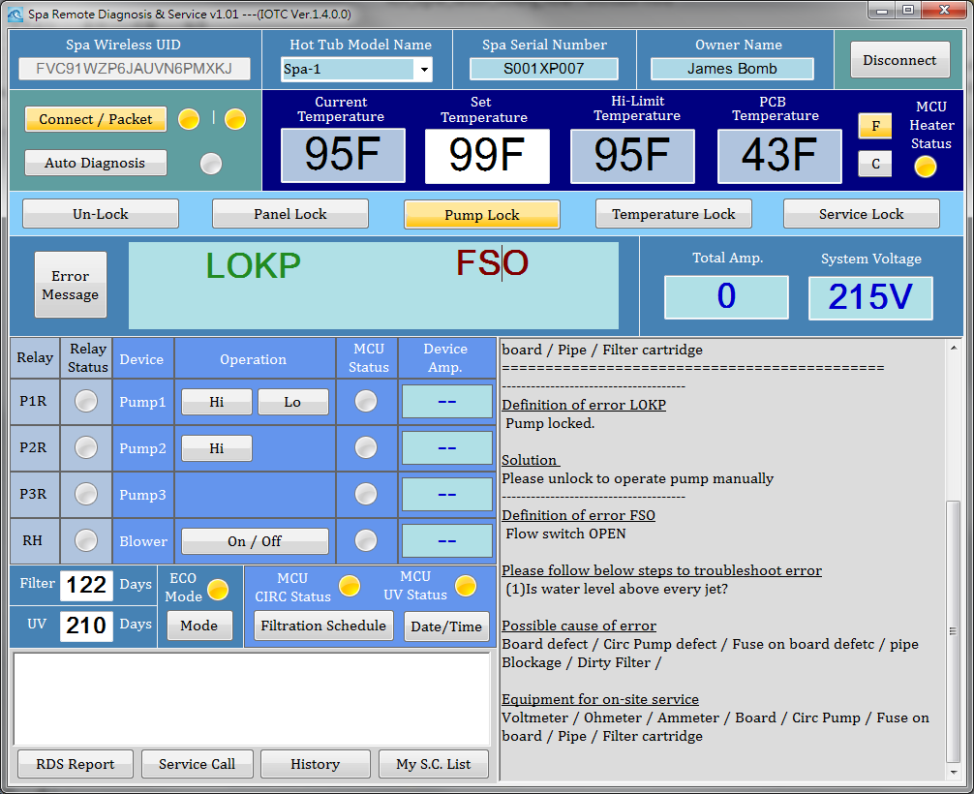
RDS (7) : Dynamic Show Error Info.
Green color:
Message, not Error
Red color: Error
Newly display
two part of info. (LOKP. FSO)

Slide 27
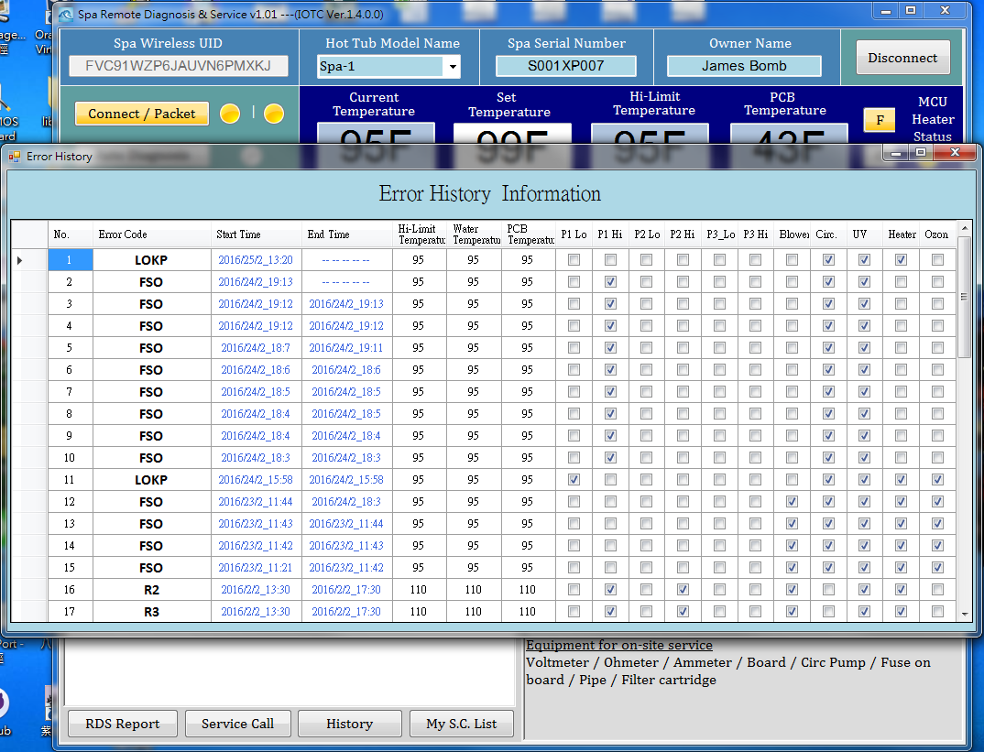
RDS(8): Error Messages
Take some time to get
max 50 recorded Errors
Which stored in SPA
Current Error
Don’t has End Time

Slide 28
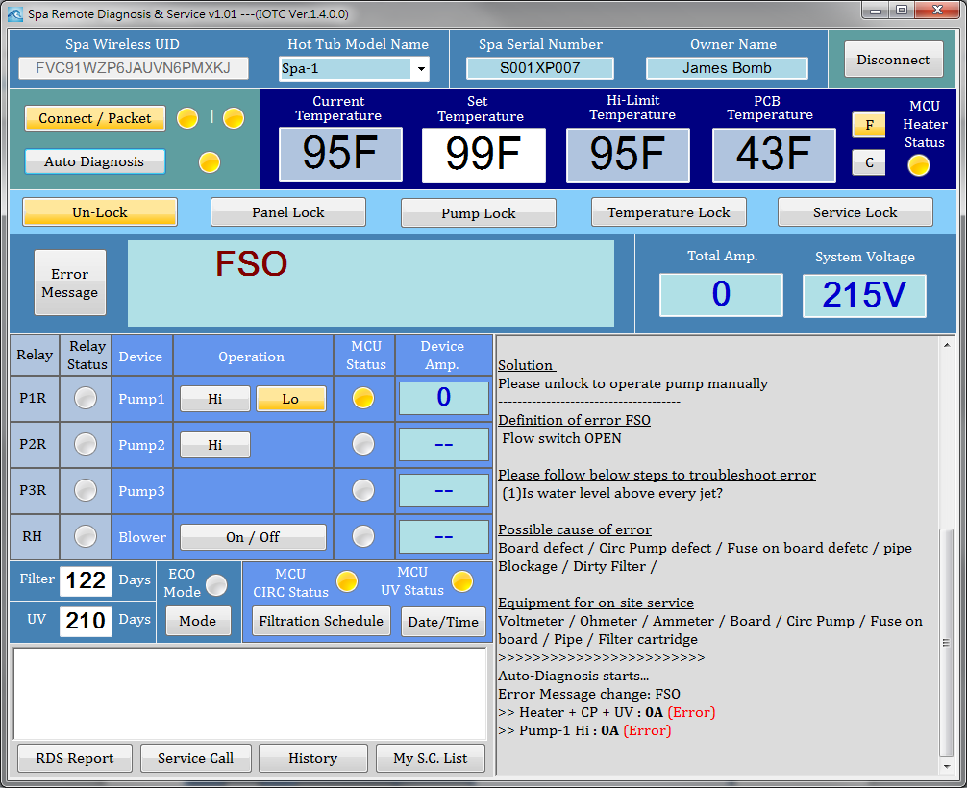
RDS(9) Auto-Diagnosis Start
Press Button,
Will Light-on when doing Auto Diagnosis
Auto-Diagnosis messages
And if errors changed message (ORG.= LOKP,FSO)

Slide 29
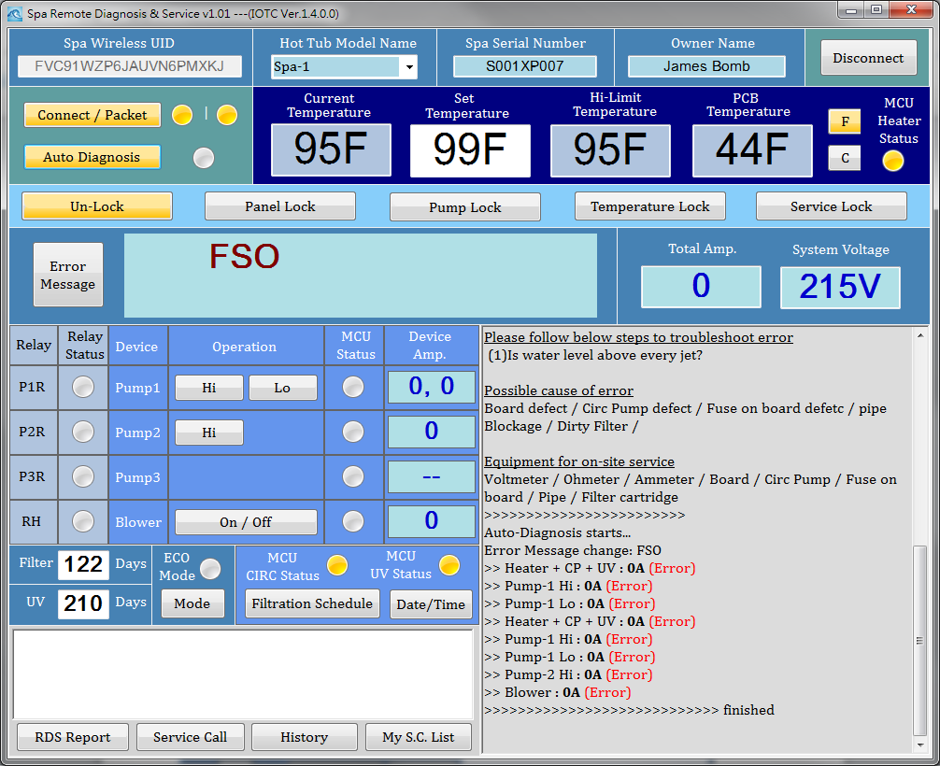
RDS(10) Auto-Diagnosis Finished
After finished,
The button will Light-On
Auto-Diagnosis finished message

Slide 30
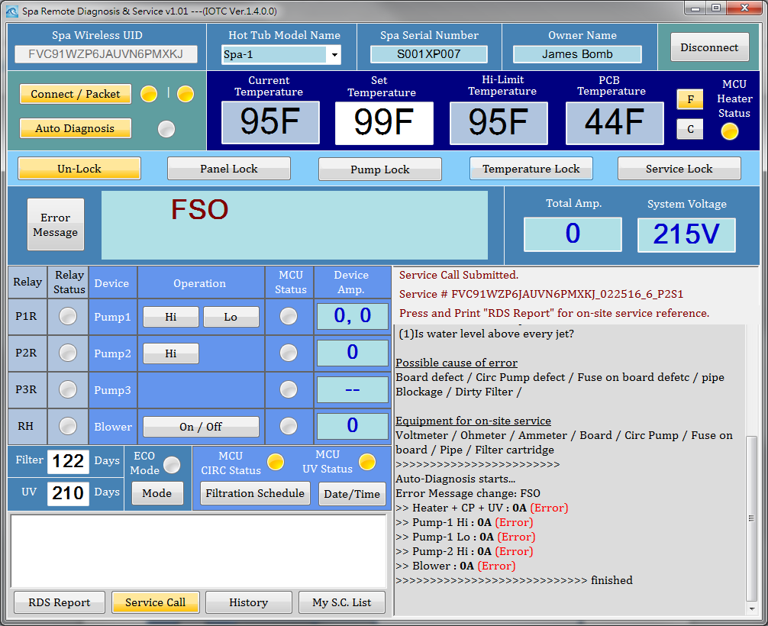
RDS(11) Produce Service Call No.
Press Button, Service Call Info. show here
After it produced.
The button will Light-On

Slide 31
RDS(12) SC No. Encoding
UID = DLCT2SZP6WUAUNPPMX6J
Report 編碼原則: UID號碼 + 日期(月日年) + 此用戶在當天的第幾筆連線,
Example: FVC91WZP6JAUVN6PMXKJ_012816_3
工單編碼: Report 編碼 + P(哪位操作員)+S (今天第幾筆工單), Example: FVC91WZP6JAUVN6PMXKJ_012816_1_P1S2
每一個Report 都有編碼
但不是每一個Report都有編碼 +工單號碼
需要工單的 Report 會有Report編碼 + 工單號碼
PS: P0 = Supervisor
工單 and RDS Report是同一份文件檔案
Example: FVC91WZP6JAUVN6PMXKJ_012816_1_P1S2.csv
Operation record (Log)所存檔案名稱也是相同編碼,
有可能有 Log 卻沒有 RDS report
Example: FVC91WZP6JAUVN6PMXKJ_012816_3.log

Slide 32
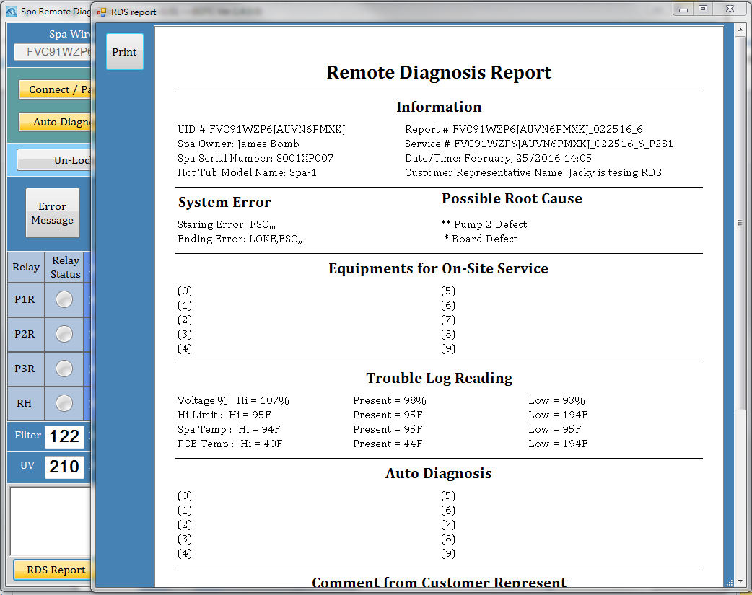
RDS(13) Produce RDS Report
Press Button,
Report show in new Form.
After it produced.
The button will Light-On

Slide 33
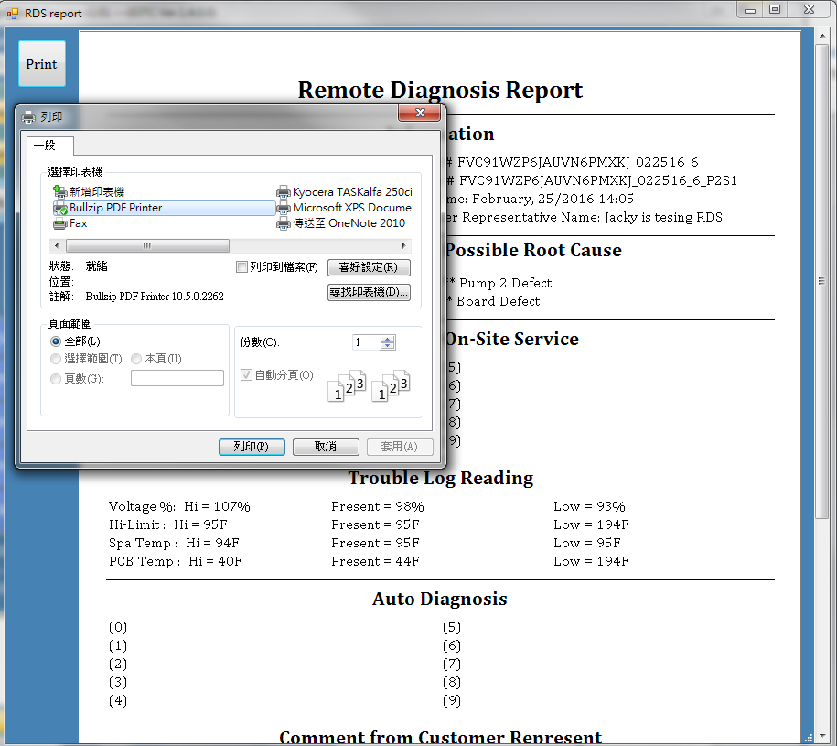
RDS(14) Printing RDS Report
Press Button,
Printer Dialog will show
(Just like Windows Application)

Slide 34
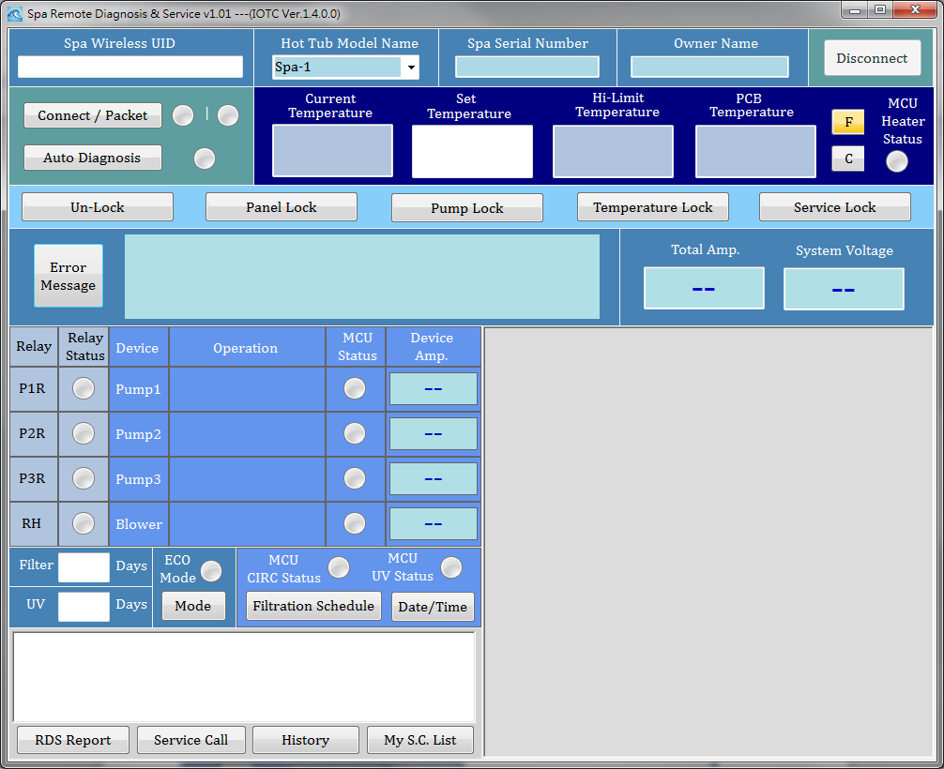
RDS(15) Clear All When Dis-connect

Slide 35
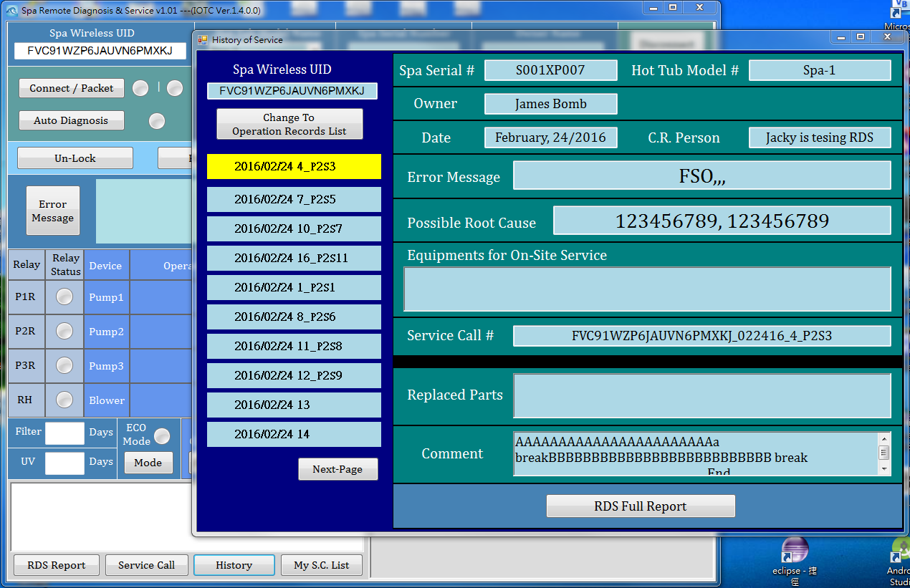
RDS(16) History of this UID
Only UID input required, Even didn’t connected,
You could press “History” button to check history of past

Slide 36
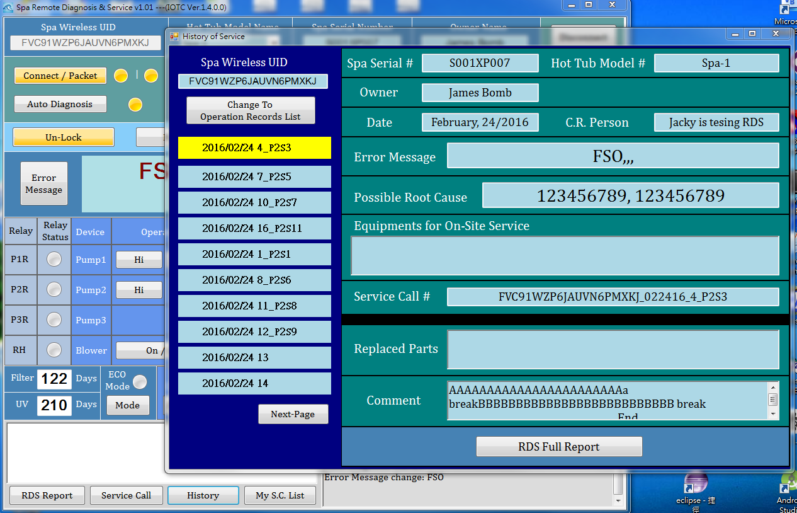
RDS(17) Check History when A.D
Even you are waiting Auto-Diagnosis
You could press “History” button
Could check
RDS full report

Slide 37
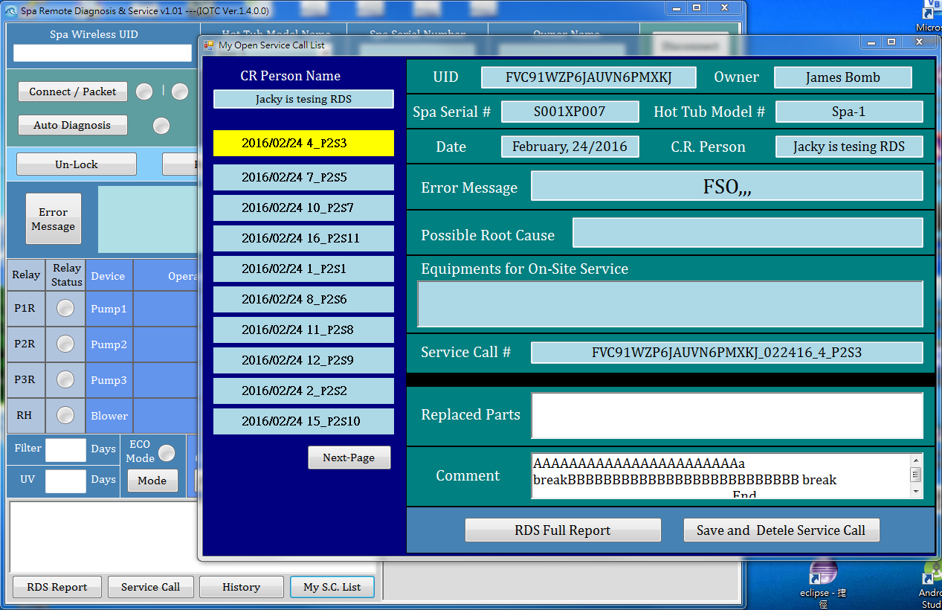
RDS(18) My Open Service Call List
Only log-in required, Even didn’t connected and No UID inputted,
You could press “My S.C. List” button to browser your open service call list
Could input
Replaced parts
& comment
Then save it
& delete this SC

Slide 38
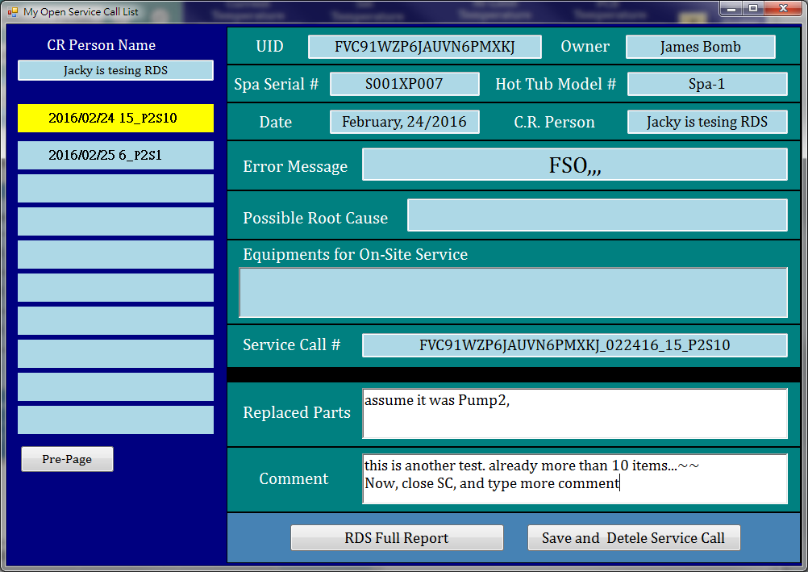
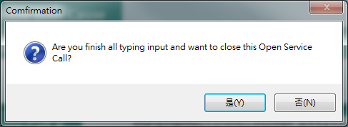
RDS(19) Close a Service Call
Press Button
& confirm it…

Slide 39
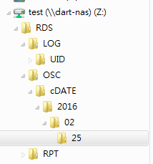
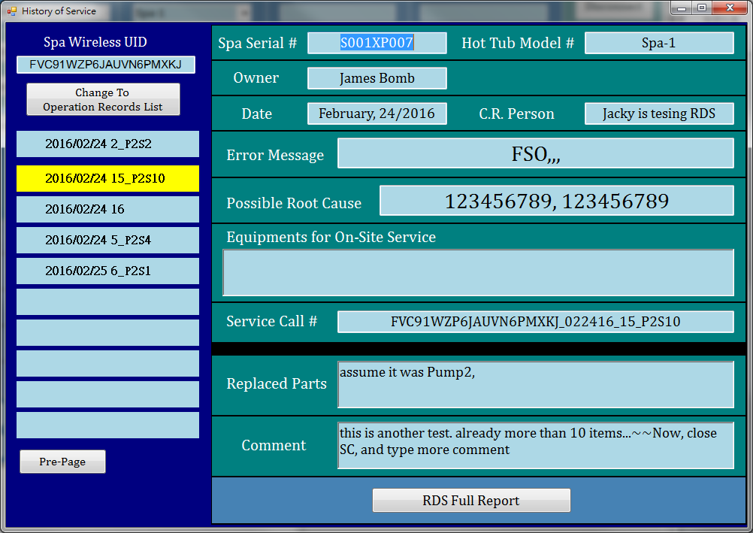
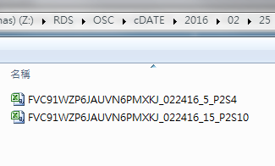
RDS(20) Check the closed Report
Use UID to see history, then it already changed
Notice that, file already deleted in OSC dir.
And the updated file already copy to both:
\RDS\RPT\UID\xxxx\xxxxxxx…xx
\RDS\OSC\cDATE\2016/02/25

Slide 40
RDS(21) Report Files
When 2/24, a service call submitted. Three file saved
\RPT\UID\xxx…
\RPT\DATE\2016\02\24\
\OSC\
0224
0224
0224
When 2/25, a service call closed. Update 1 file, Delete 1 file and Add 1 file.
\RPT\UID\xxx…
\RPT\DATE\2016\02\24\
\OSC\
0224
0224
\OSC\cDATE\2016\02\25
0224

Slide 41
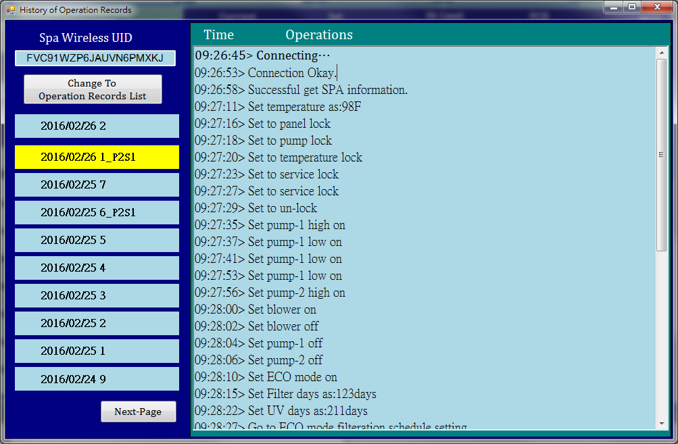
RDS(22) Operation Records

Slide 42
Process of Auto-Diagnosis
設定un-lock, 設定 STD mode, 設定filter schedule讓當下時間不是循環時段, 並且記住原來的設定水溫, 原來的STD/ECO mode, 原來的filter schedule
如果SPA正在加熱, (會看到 Heater + Circ + UV all on) 則先進行(3)(4), 再進行(5), 然後(8)結束 如果SPA沒有在加熱, (Heater + Circ + UV all off), 則先進行(5), 再進行(6)(7), 然後(8)結束 如果SPA正在加熱, (會看到 Heater + Circ + UV all on) 但目前水溫過低 則直接進行(5), 然後(8)結束
關掉所有pump/blower, 量測電流 (heater+循環)
讓設定溫度比水溫低2度F, 量測電流 (循環only), 再一分鐘等待循環結束
關掉所有pump/blower, 再依序單獨開各個pump/blower 量測電流
讓設定溫度比水溫高2度F, 量測電流 (循環only)
等一分鐘,(heater on), 量測電流 (heater+循環)
回復原來的設定,結束.

Slide 43
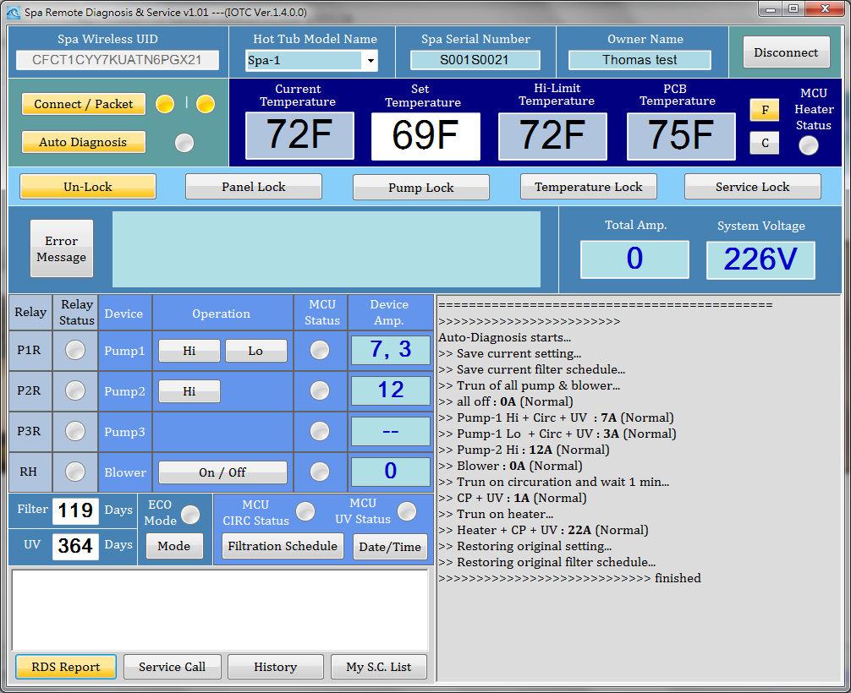
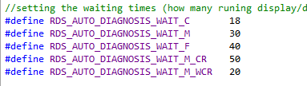
Note: Total time of A.D.(1)
>>>>>>>>>>>>>>>>>>>>>>>>
Auto-Diagnosis starts...
22:45:25> ---- S_idel ---
22:45:25> to C_std
22:45:29> to S_saveFsch
>> Save current setting...
22:45:29> to C_saveFsch
22:45:33> to S_setFsch
>> Save current filter schedule...
22:45:33> to C_setFsch
>> Trun of all pump & blower...
22:45:41> to S0_all_off
22:45:41> to C0_all_off
22:45:45> C0_all_off
22:45:51> M0_all_off
>> all off : 0A (Normal)
22:45:51> S1_P1_hi
22:45:55> C1_P1_hi
22:45:55> S1_P1_hi
22:45:59> C1_P1_hi
22:45:59> S1_P1_hi
22:46:03> C1_P1_hi
22:46:09> M1_P1_hi
>> Pump-1 Hi + Circ + UV : 7A (Normal)
22:46:09> S2_P1_lo
22:46:12> C2_P1_lo
22:46:18> M2_P1_lo
>> Pump-1 Lo + Circ + UV : 3A (Normal)
22:46:18> S3_P2_hi
22:46:22> C3_P2_hi
22:46:22> S3_P2_hi
22:46:26> C3_P2_hi
22:46:32> M3_P2_hi
>> Pump-2 Hi : 12A (Normal)
22:46:32> S7_blower
22:46:36> C7_blower
22:46:42> M7_blower
>> Blower : 0A (Normal)
>> Trun on circuration...
22:46:56> M_HeatOn_CircOnly
>> CP + UV : 1A (Normal)
22:47:00> W_HeatON_CircOn
22:47:04> W_HeatON_CircOn
22:47:08> W_HeatON_CircOn
22:47:12> W_HeatON_CircOn
22:47:16> W_HeatON_CircOn
22:47:20> W_HeatON_CircOn
22:47:25> W_HeatON_CircOn
22:47:29> W_HeatON_CircOn
22:47:33> W_HeatON_CircOn
22:47:37> W_HeatON_CircOn
22:47:41> W_HeatON_CircOn
22:47:45> W_HeatON_CircOn
22:47:49> W_HeatON_CircOn
>> Trun on heater...
22:47:55> M_HeatOn_CircOn
>> Heater + CP + UV : 21A (Normal)
>> Restoring original setting...
22:47:55> S_Over
22:47:59> C_Over
22:47:59> S_Over_SetT, setT as 69
22:48:03> C_Over_SetT
>> Restoring original filter schedule...
22:48:03> S_bkFsch
22:48:11> C_bkFsch
>>>>>>>>>>>>>>>>>>>>>>>>>>>> finished
Case: Heater-off & Circ+UV off
With following setting
3 min 左右

Slide 44
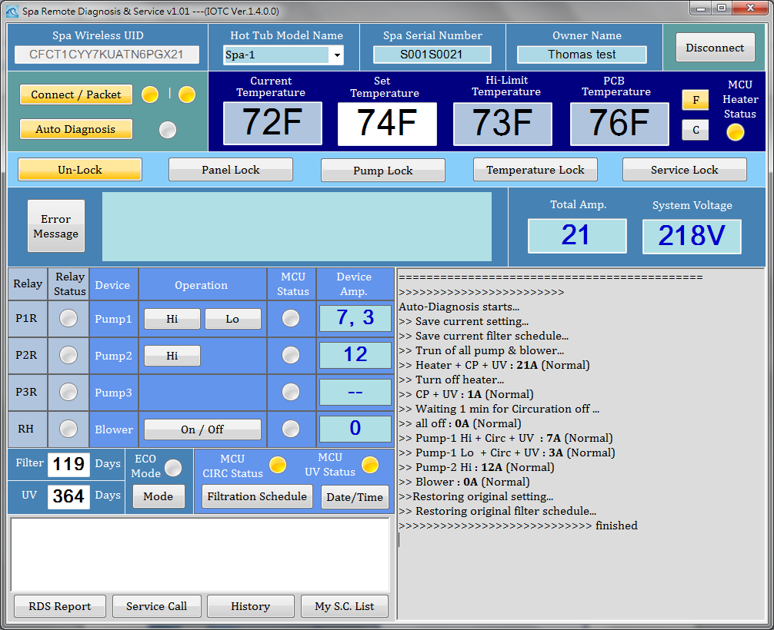
Note: Total time of A.D.(2)
>>>>>>>>>>>>>>>>>>>>>>>>
Auto-Diagnosis starts...
23:05:44> ---- S_idel ---
23:05:44> to C_std
23:05:47> to S_saveFsch
>> Save current setting...
23:05:47> to C_saveFsch
23:05:51> to S_setFsch
>> Save current filter schedule...
23:05:51> to C_setFsch
>> Trun of all pump & blower...
23:05:59> to S_HC_all_off
23:05:59> to C_HC_all_off
23:06:03> C_HC_all_off
23:06:09> M_HC_all_off,
>> Heater + CP + UV : 21A (Normal)
>> Turn off heater...
23:06:09> S_HeatOff, curWaterT=72
23:06:13> C_HeatOff
23:06:23> M_HeatOff_CircOnly
>> CP + UV : 1A (Normal)
>> Waiting Circuration off...
23:06:27> W_CircOff
23:06:31> W_CircOff
23:06:35> W_CircOff
23:06:39> W_CircOff
23:06:43> W_CircOff
23:06:47> W_CircOff
23:06:51> W_CircOff
23:06:56> W_CircOff
23:07:00> W_CircOff
23:07:04> W_CircOff
23:07:08> W_CircOff
23:07:12> W_CircOff
23:07:12> to C0_all_off
23:07:16> C0_all_off
23:07:22> M0_all_off
>> all off : 0A (Normal)
23:07:22> S1_P1_hi
23:07:26> C1_P1_hi
23:07:33> M1_P1_hi
>> Pump-1 Hi + Circ + UV : 7A (Normal)
23:07:33> S2_P1_lo
23:07:37> C2_P1_lo
23:07:43> M2_P1_lo
>> Pump-1 Lo + Circ + UV : 3A (Normal)
23:07:43> S3_P2_hi
23:07:47> C3_P2_hi
23:07:53> M3_P2_hi
>> Pump-2 Hi : 11A (Normal)
23:07:53> S7_blower
23:07:57> C7_blower
23:08:03> M7_blower
>> Blower : 0A (Normal)
>>Restoring original setting...
23:08:03> S_Over
23:08:07> C_Over
23:08:07> S_Over_SetT, setT as 73
23:08:11> C_Over_SetT
>> Restoring original filter schedule...
23:08:11> S_bkFsch
23:08:19> C_bkFsch
>>>>>>>>>>>>>>>>>>>>>>>>>>>> finished
Case: Heater-off & Circ+UV On
With following setting
3 min 左右

Slide 45
Error code and Auto-Diagnosis
Error Codes |  | Definition | Can do Auto Diagnosis ? | Possible Result
Old | New |  |  | if happen | then it's….
WSO | SN1 | Water temperature sensor OPEN | Y
WSS | SN2 | Water temperature sensor SHORT | Y
HSO | SN3 | Hi-Limit temperature sensor OPEN | Y
HSS | SN4 | Hi-Limit temperature sensor SHORT | Y
PSO | SN5 | PCB temperature sensor OPEN | Y
PSS | SN6 | PCB temperature sensor SHORT | Y
LOKA | L1 | Panel Locked. All functions locked. | Y
LOKP | L2 | Pump locked. | Y
LOKE | L3 | Temperature locked. | Y
LOKS | L4 | Service locked. for 120 minutes | Y
FSO | FL1 | Flow switch OPEN | Y
FSC | FL2 | Flow switch CLOSE | Y
FSC1 | FLO2 | Flow switch CLOSE - 1 | N
R1 | .. | Pump 1 high speed relay fuse | N
R2 | .. | Pump 2 high speed relay fuse | N
R3 | .. | Pump 3 high speed relay fuse | N
RH | .. | Heater relay fuse | N
WHO | OH | Water is over heated | Y
WCL | COOL | Water is cool | Y
WICE | ICE | Water is too cold | Y
WWD | WWD | Water is too hot | N
CBB | BLB | UV light usage expired | Y
FEX | CF | Filter usage expired | Y
PCBH | HOT | PCB Temperature exceeds 180F | Y

Slide 46
Possible Cause & Equipment
code (8 bit) | from | Cause | Equpipments | comment
0 |  | None. (Reserved for empty) | None
1 | Err1234 | Water temperature sensor defect | Water temperature sensor
2 | Err1234 | Hi-limit temperature sensor defect | Hi-limit temperature sensor
3 | Err1234 | Circ Pump defect | Circ Pump
4 | Err1234 | Fuse on board defect | Fuse
5 | Err1234 | Pipe Blockage | Pipe
6 | Err1234 | Dirty Filter | Filter cartridge | same as 9
7 | Err1234 | Flow Switch defect | Flow Switch | FSO , during AD measureent
8 | Err1234 | UV light usage expired | UV light
9 | Err1234 | Filter Cartridge expired | Filter Cartridge | same as 6, use 6
10 | Err1234 | Board defect | Board
11 | Err1234 | Topside defect | Topside
12 | A.D. | Pump-1 Hi (line) defect | Pump-1 Hi
13 | A.D. | Pump-1 Lo (line) defect | Pump-1 Lo
14 | A.D. | Pump-2 Hi (line) defect | Pump-2 Hi
15 | A.D. | Pump-2 Lo (line) defect | Pump-2 Lo
16 | A.D. | Pump-3 Hi (line) defect | Pump-3 Hi
17 | A.D. | Pump-3 Lo (line) defect | Pump-3_Lo
18 | A.D. | Blower (line) defect | Blower
19 | A.D. | Circ Pump + UV (line) defect | Circ Pump + UV light
20 | A.D. | Heater (line) defect | Heater

Slide 47

RDS Related System File
In RDS root directory Z:\RDS\
User.ini ➔ RDS user accounts
In open service call Dir. Z:\OSC\
[1,2,…].work
➔ keep last SC number
➔ by each operator

Slide 48
RDS-admin program

Slide 49
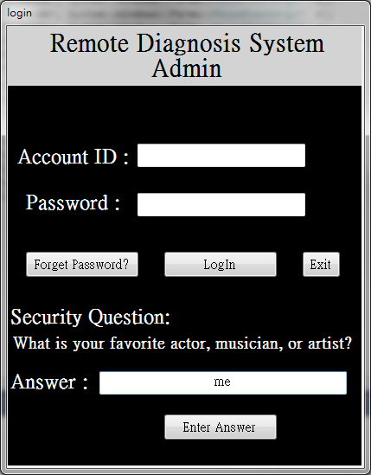
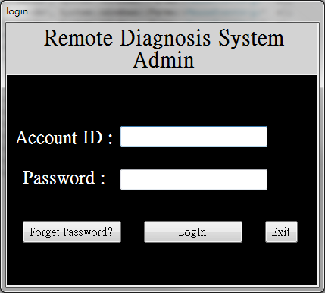
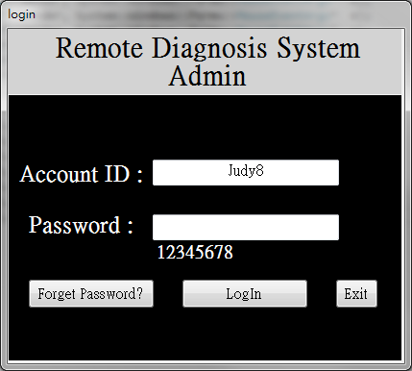
RDS admin(1) Login

Slide 50
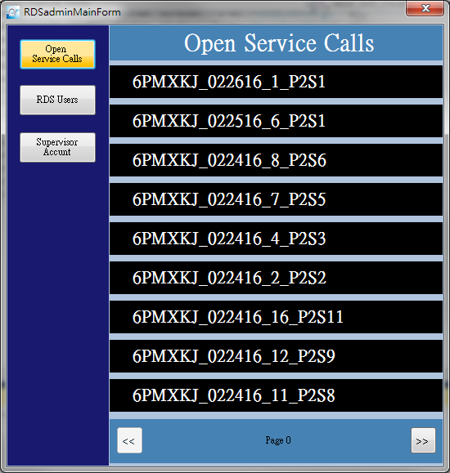
RDS admin (2) mainly show Open Service Call List

Slide 51
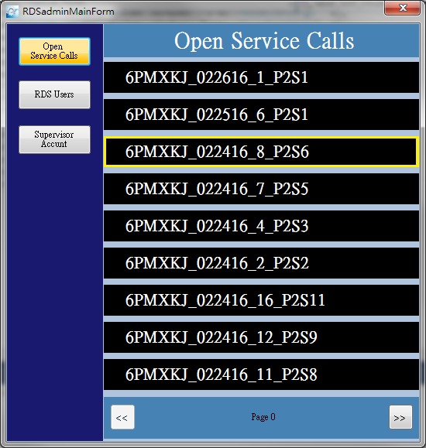
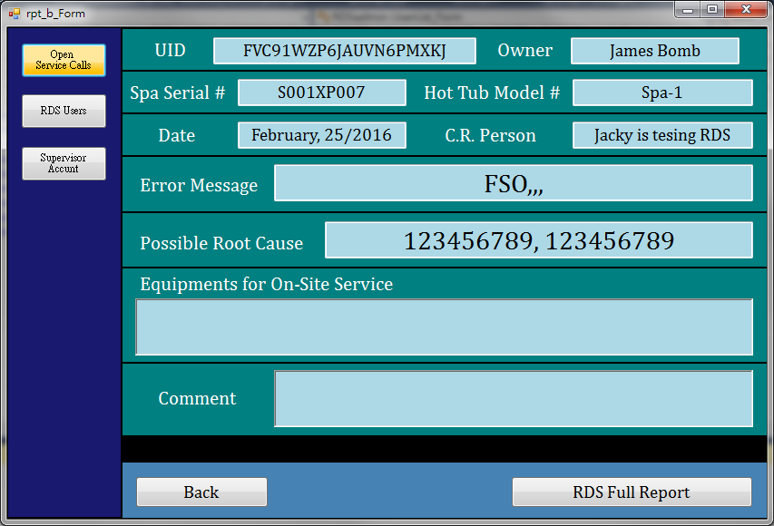
RDS admin (3) check it’s brief report
Click
Double
Click

Slide 52
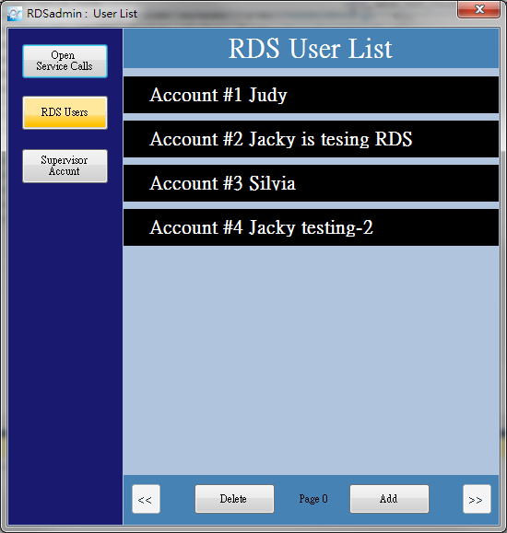
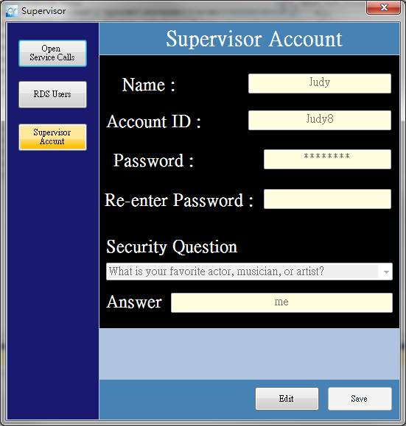
RDS admin (4) Menu buttons

Slide 53

RDS admin (5) Supervisor Account
Just show information….
Can be edit and Save…

Slide 54

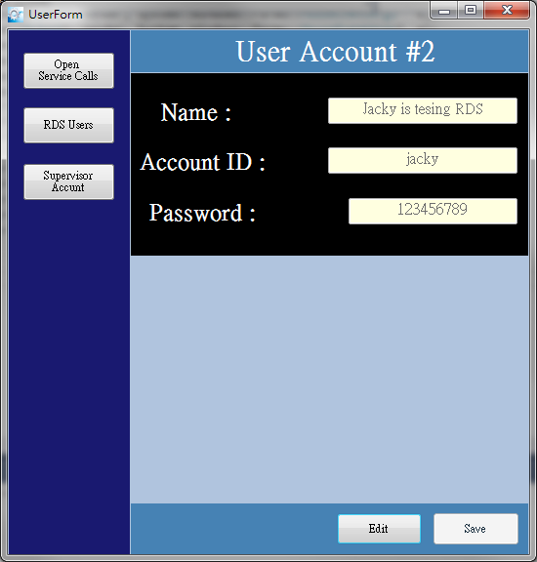
RDS admin (6) User List
Click
Double Click

Slide 55
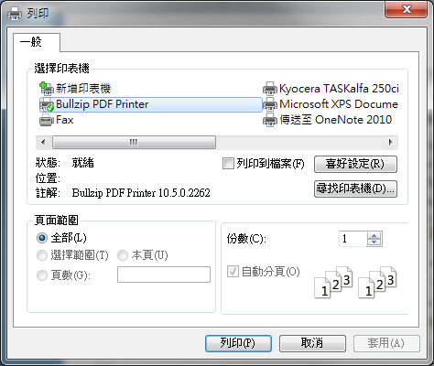
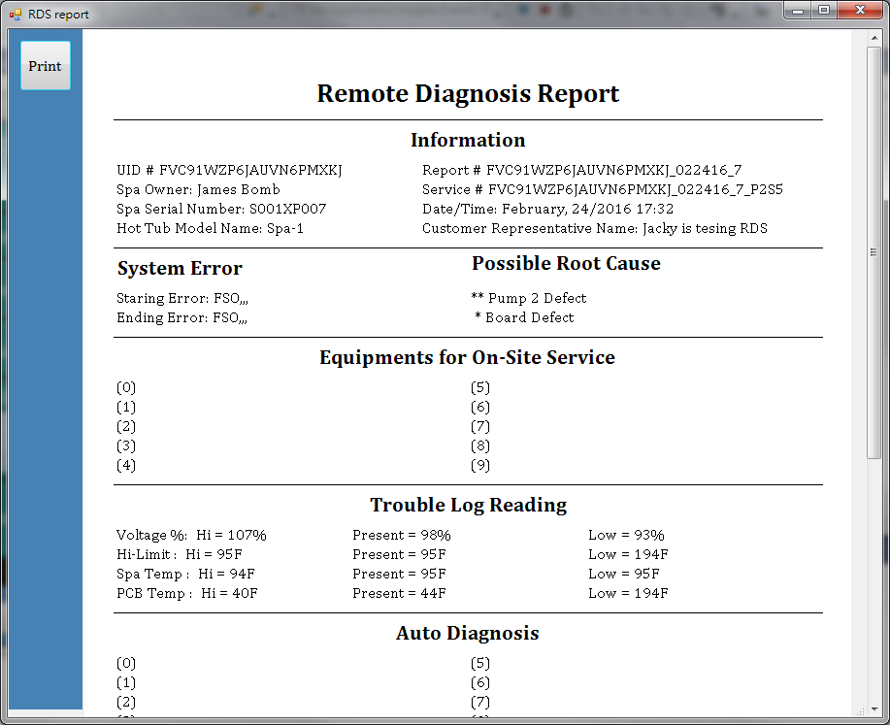
RDS admin (7) RDS Full Report

Slide 56
RDS-admin Related System File
In RDS root directory
System.ini ➔ Supervisor account
User.ini ➔ RDS user accounts

Slide 57
Back-Up

Slide 58
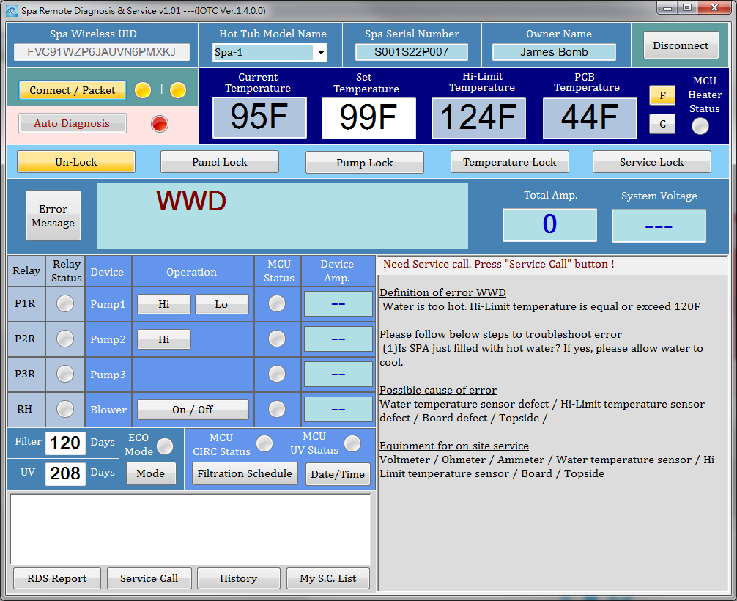
Some Error Can Not Do Auto-Diagnosis
In following Error case, user can not do auto-diagnosis:
WWD
FSC1
R1
R2
R3
RH

Slide 59

If lose connection when service…

Slide 60

A.D. Example: Heat off & Circ. off

Slide 61

A.D. Example: Heat on & Circ. on

Slide 62

No Spa-Serial & Model-Name Cannot do RDS Report

